Slide 1
CHM 4444,
Advanced Inorganic Chemistry

Slide 2
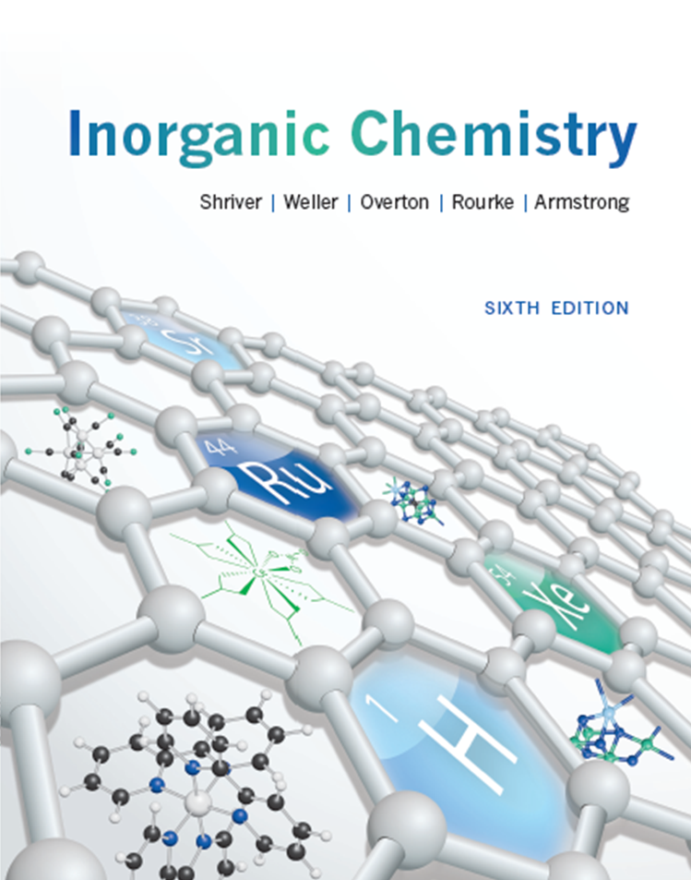

Slide 3
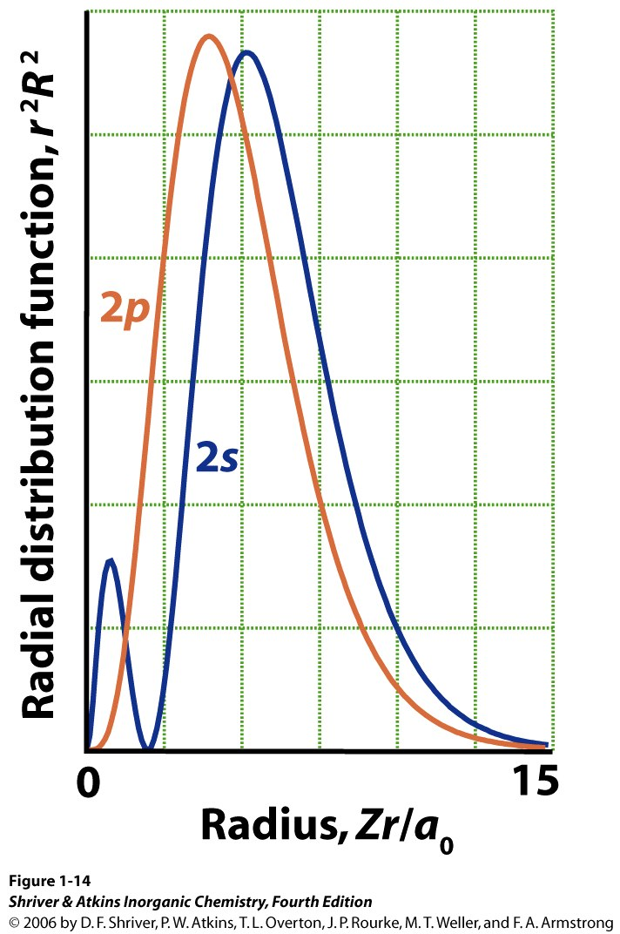
Chapters
1, Atomic structure
2, Molecular structure & bonding
3, Structures of simple solids
6, Molecular symmetry
7, Introduction to coordination compounds
20, d-Metal complexes: electronic structure and spectra
Notes:
Acids & bases: both kinds
Coordination compounds: naming

Slide 4
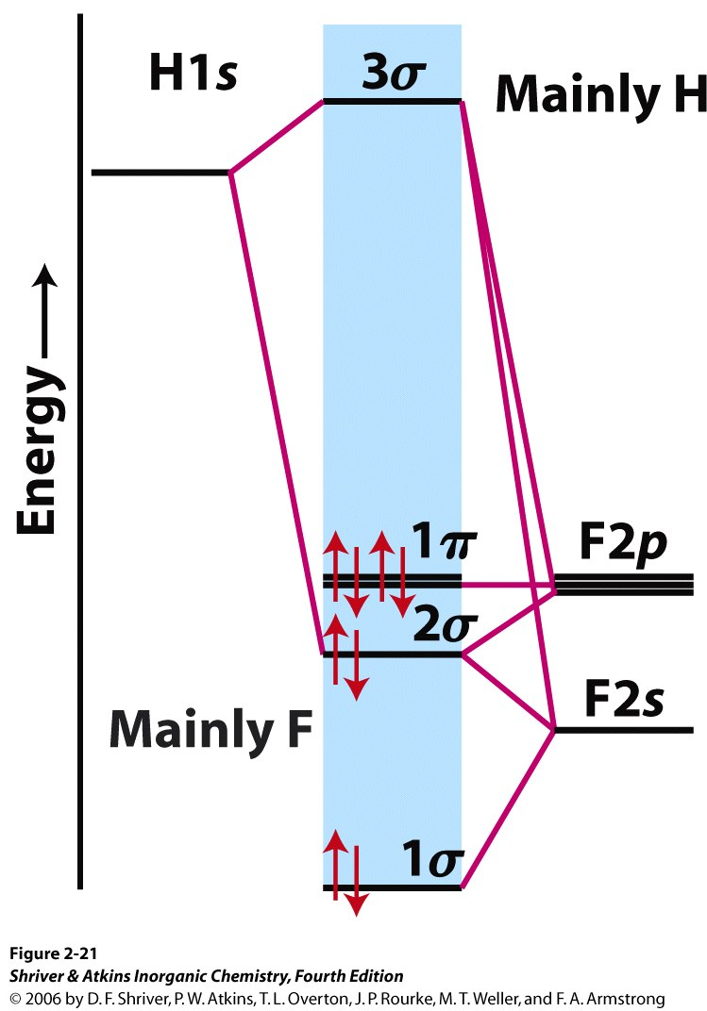
Chapters
1, Atomic structure
2, Molecular structure & bonding
3, Structures of simple solids
6, Molecular symmetry
7, Introduction to coordination compounds
20, d-Metal complexes: electronic structure and spectra
Notes:
Acids & bases: both kinds
Coordination compounds: naming

Slide 5
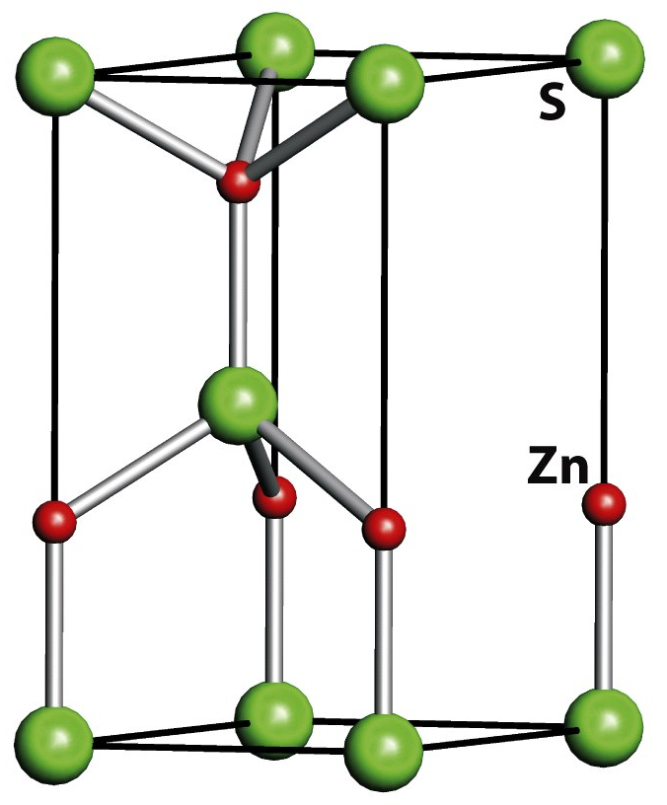
Chapters
1, Atomic structure
2, Molecular structure & bonding
3, Structures of simple solids
6, Molecular symmetry
7, Introduction to coordination compounds
20, d-Metal complexes: electronic structure and spectra
Notes:
Acids & bases: both kinds
Coordination compounds: naming

Slide 6
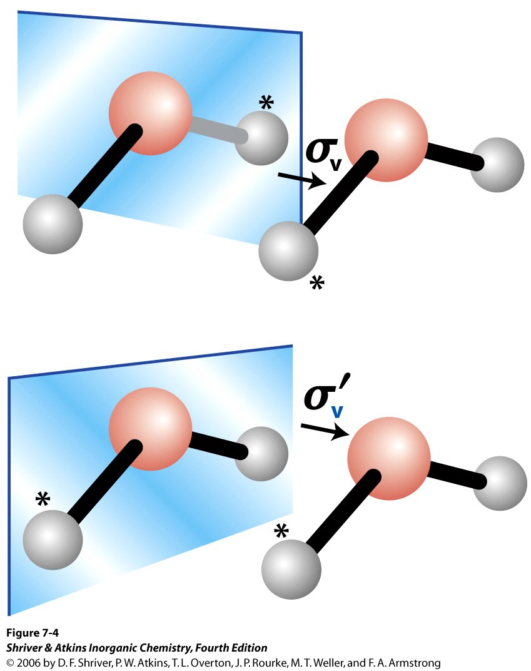
Chapters
1, Atomic structure
2, Molecular structure & bonding
3, Structures of simple solids
6, Molecular symmetry
7, Introduction to coordination compounds
20, d-Metal complexes: electronic structure and spectra
Notes:
Acids & bases: both kinds
Coordination compounds: naming

Slide 7
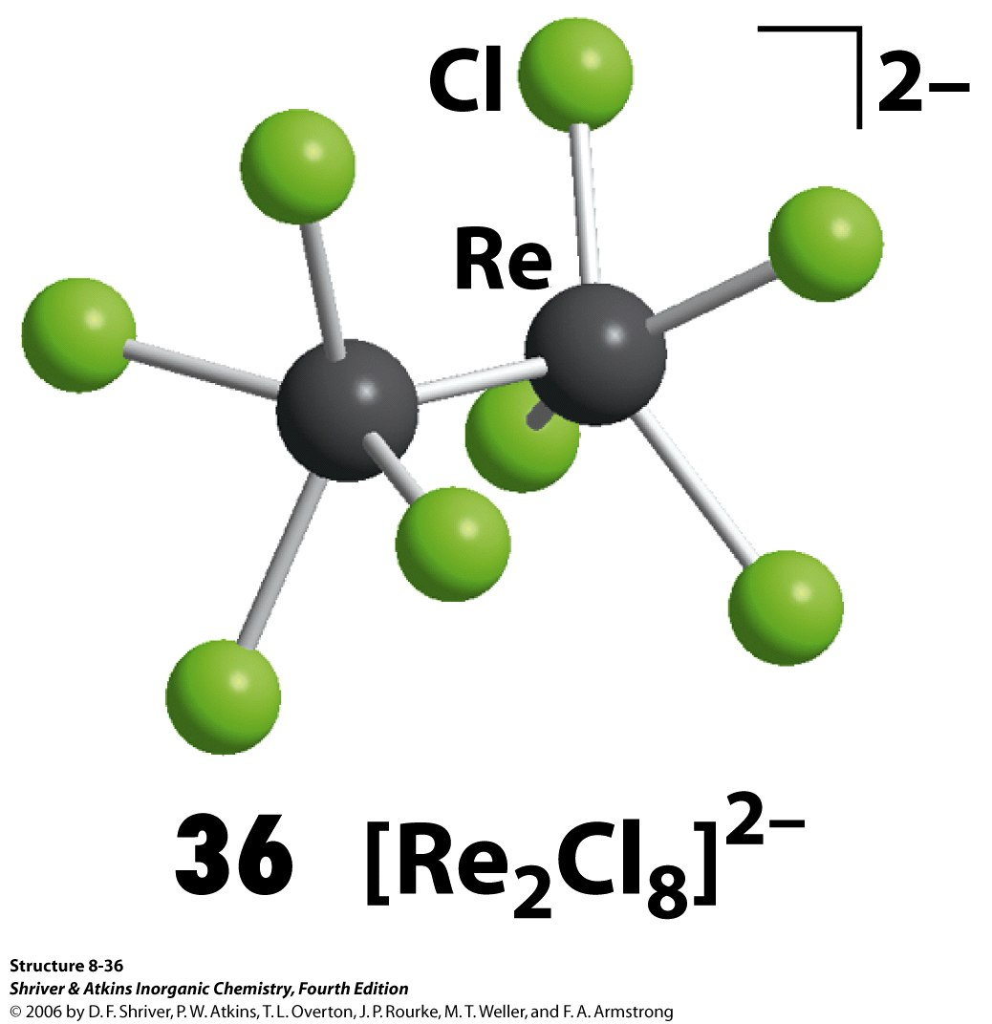
Chapters
1, Atomic structure
2, Molecular structure & bonding
3, Structures of simple solids
6, Molecular symmetry
7, Introduction to coordination compounds
20, d-Metal complexes: electronic structure and spectra
Notes:
Coordination compounds: naming

Slide 8
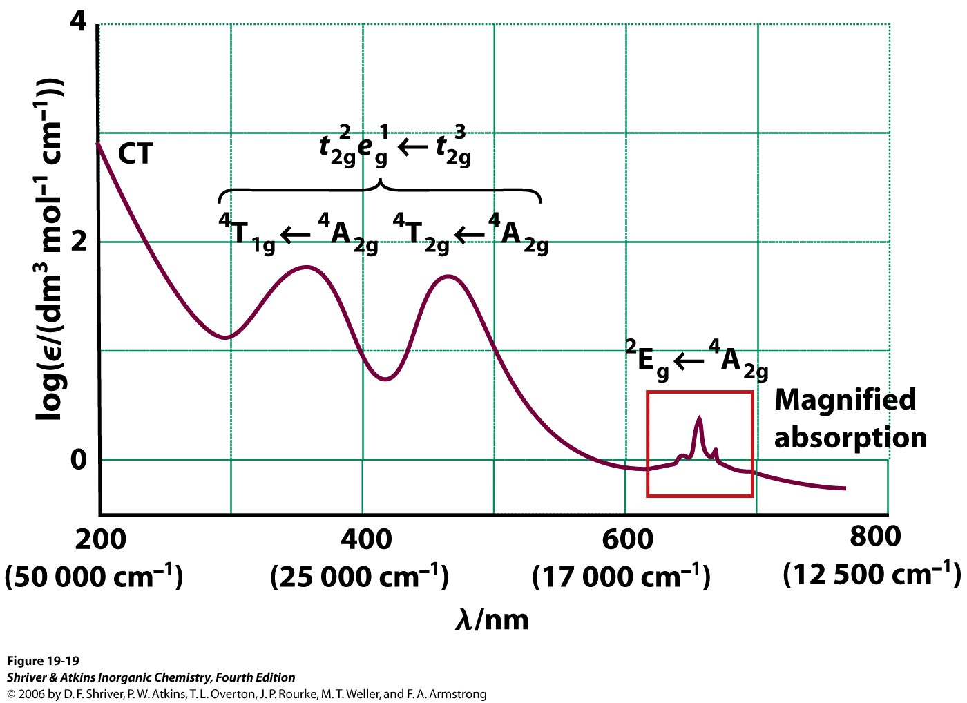
Chapters
1, Atomic structure
2, Molecular structure & bonding
3, Structures of simple solids
6, Molecular symmetry
7, Introduction to coordination compounds
20, d-Metal complexes: electronic structure and spectra
Notes:
Coordination compounds: naming

Slide 9
Chapter 1
Atomic Structure

Slide 10
Chapter 1: Atomic Structure
1.1 The nucleosynthesis of light elements
1.2 The nucleosynthesis of heavy elements
1.3 Spectroscopic information
1.4 Some principles of quantum mechanics
1.5 Atomic orbitals
1.6 Penetration and shielding
1.7 The building-up principle
1.8 The classification of the elements
1.9 Atomic parameters

Slide 11
Chapter 1: Atomic Structure
1.1 The nucleosynthesis of light elements
1.2 The nucleosynthesis of heavy elements
1.3 Spectroscopic information
1.4 Some principles of quantum mechanics
1.5 Atomic orbitals
1.6 Penetration and shielding
1.7 The building-up principle
1.8 The classification of the elements
1.9 Atomic parameters

Slide 12
Section 1.0 Objectives
Know what a nucleon is.
nucleon: a collective name for two particles:
the neutron and the proton.
Wikipedia

Slide 13
Section 1.0 Objectives
Describe the origin of H and He in terms of the big bang, electromagnetic force, and the strong force.
Notes:
Strong force holds nucleons together
He just formed in the big bang; no details

Slide 14
“Gödel, Escher, Bach” by D. Hofstadter
Gödel’s Incompleteness Theorem (1st part)
Any effectively generated theory capable of expressing elementary arithmetic cannot be both consistent and complete. In particular, for any consistent, effectively generated formal theory that proves certain basic arithmetic truths, there is an arithmetical statement that is true, but not provable in the theory.
From Wikipedia
Notes:
End of lecture.

Slide 15
Section 1.0 Objective
What is the most abundant element in the universe?
What is the second most abundant element?
Estimated Current composition of the universe:
89% H
11% He

Slide 16
Section 1.0 Objectives
Use the nucleon number to describe isotopes and nuclides.
Isotopes: have same number of protons
nuclide: an atomic species characterized by
the specific constitution of its nucleus:
number of protons, Z,
number of neutrons, N, and
nuclear energy state.
nucleon number: sum of Z and N
P-31, ¹²C
Wikipedia
Notes:
What has same number of protons?
What are nuclides that have the same number of protons called?

Slide 17
Section 1.0 Objectives
Given a fundamental particle, state what its properties are, and vice versa.

Slide 18
Subatomic particles relevant to chemistry
mass
particle symbol mass/u* number charge/e† spin
proton p 1.0073 1 +1 ½
neutron n 1.0087 1 0 ½
electron e– 0.0005486 0 –1 ½
positron e⁺ 0.0005486 0 +1 ½
α particle α nucleus of He-4 4 +2 0
ß particle ß e– ejected from nucleus 0 –1 ½
photon γ 0 0 0 1
γ photon γ photon from nucleus 0 0 1
neutrino ν very small 0 0 ½
*Masses are given in atomic mass units; m_{u} = 1.6605 × 10^{–27} kg
†The elementary charge, e = 1.602 × 10^{–19} C
Notes:
Explain m_{u}, the atomic mass constant. It’s like Avogadro’s number, and is used in conversion factors.
PET scan: positron emission tomography
neutrino emission is found in the carbon cycle.

Slide 19
Section 1.1 Objectives
Use “nuclear math” to complete a nuclear reaction.
Mass is conserved
12
6
+
4
2
→
16
8
+ γ
ΔE = -7.2 MeV
C
α
O
Charge is conserved
Notes:
NEEDS PRACTICE PROBLEMS

Slide 20




Section 1.1 Objectives
Given the conversion factor, convert between eV and kJ/mol.
1 eV = 1.602 × 10⁻¹⁹ J, or 96.48 kJ/mol
12
6
+
4
2
→
16
8
+ γ
ΔE = -7.2 MeV
C
α
O
ΔE = -7.2 MeV
$$\left(\frac{1×{10}^{6} \text{eV}}{1 \text{MeV}}\right)$$
$$\left(\frac{1.602×{10}^{−19} \text{J}}{1 \text{eV}}\right)$$
= -1.15 × 10^{–12} J
$$\left(\frac{1×{10}^{−3} \text{kJ}}{1 \text{J}}\right)$$
$$\left(\frac{6.022×{10}^{23}}{1 \text{mol}}\right)$$
= -6.94 × 10⁸ kJ/mol
Notes:
End of lecture 2

Slide 21
Section 1.1 Objectives
Calculate the nuclear binding energy per nucleon of a nuclide.
Nuclear binding energy:
  Energy required to split the nucleus of an atom into its component parts.
atom + binding energy → nucleons + electrons
Wikipedia
Notes:
How nuclear energy works
Relate this to the strong force.
Quiz on this next time.

Slide 22
Nuclear binding energy
  Calculate nuclear binding energy using the equivalence of mass and energy: E = mc².
atom + binding energy → nucleons + electrons
m_{atom} + m_{energy} = m_{nucleons} + m_{electrons}
m_{energy} = m_{nucleons} + m_{electrons} – m_{atom}
E = mc² = (m_{nucleons} + m_{electrons} – m_{atom})c²
Notes:
(Have to divide by number of nucleons.)
End of Lecture 2.

Slide 23
Nuclear binding energy
  Calculate nuclear binding energy using the equivalence of mass and energy: E = mc².
E = mc² = (m_{nucleons} + m_{electrons} – m_{atom})c²
Constants
neutron | 1.008665 u
proton | 1.007277 u
electron | 0.000548 u
u → kg | 1.66054 × 10⁻²⁷ kg/ u
c | 2.99793 × 10⁸ m/s
J → eV | 1.60218 × 10⁻¹⁹ J/eV
Notes:
(Have to divide by number of nucleons.)
Go to spreadsheet.

Slide 24

Example
Calculate the nuclear binding energy per nucleon in MeV for ${}_{7}^{14}{\text{N}}$, which has a mass of 14.00307 u.
Mass of N-14 components:
7 p
7 × 1.007277 u
= 7.050939 u
7 n
7 × 1.008665 u
= 7.060655 u
7 e⁻
7 × 0.000548 u
= 0.003836 u
Constants
14.115430 u
neutron | 1.008665 u
proton | 1.007277 u
electron | 0.000548 u
Difference in Mass: 0.11236 u

Slide 25




Example
Difference in Mass: 0.11236 u
E = mc²
$$\left(\frac{1.66054×{10}^{−27} \text{kg}}{u}\right)$$
$${\left(\frac{2.99793×{10}^{8} \text{m}}{\text{s}}\right)}^{2}$$
E = 0.11236 u
= 1.67688 × 10⁻¹¹ J
E = 1.67688 × 10⁻¹¹ J
$$\left(\frac{1 \text{eV}}{1.60218×{10}^{−19} \text{J}}\right)$$
$$\left(\frac{1 \text{MeV}}{1×{10}^{6} \text{eV}}\right)$$
Constants
u → kg | 1.66054 × 10⁻²⁷ kg/u
c | 2.99793 × 10⁸ m/s
J → eV | 1.60218 × 10⁻¹⁹ J/eV

Slide 26
Example
Difference in Mass: 0.11236 u
E = mc²
$$\left(\frac{1.66054×{10}^{−27} \text{kg}}{\text{u}}\right)$$
$${\left(\frac{2.99793×{10}^{8} \text{m}}{\text{s}}\right)}^{2}$$
E = 0.11236 u
= 1.67688 × 10⁻¹¹ J
E = 1.67688 × 10⁻¹¹ J
$$\left(\frac{1 \text{eV}}{1.60218×{10}^{−19} \text{J}}\right)$$
$$\left(\frac{1 \text{MeV}}{1×{10}^{6} \text{eV}}\right)$$
= 104.663 MeV
Binding energy per nucleon = 104.663 MeV
14
Binding energy per nucleon = 7.1759 MeV

Slide 27
Notes:
Changed sign, since focusing on forming instead of taking apart.
Fe is the most stable element. Fe and Ni meteorites.
Where do the heavier elements come from.

Slide 28
Quiz Name: __________________
Calculate the nuclear binding energy per nucleon of O-16 in MeV.
neutron | 1.008665 u
proton | 1.007277 u
electron | 0.000548 u
¹⁶O | 15.99491 u
u → kg | 1.66054 × 10⁻²⁷ kg/u
c | 2.99793 × 10⁸ m/s
J → eV | 1.60218 × 10⁻¹⁹ J/eV
Notes:
(Should be positive)
Answer: +7.97649 MeV

Slide 29

Quiz answer, p. 1
Calculate the nuclear binding energy per nucleon in MeV for ${}_{8}^{16}{\text{O}}$, which has a mass of 15.99491 u.
Mass of O-16 components:
8 p
8 × 1.007277 u
= 8.058216 u
8 n
8 × 1.008665 u
= 8.069320 u
8 e⁻
8 × 0.000548 u
= 0.004384 u
Constants
16.131920 u
neutron | 1.008665 u
proton | 1.007277 u
electron | 0.000548 u
Difference in Mass: 0.13701 u

Slide 30
Quiz answer, p. 2
Difference in Mass: 0.13701 u
E = mc²
$$\left(\frac{1.66054×{10}^{−27} \text{kg}}{u}\right)$$
$${\left(\frac{2.99793×{10}^{8} \text{m}}{\text{s}}\right)}^{2}$$
E = 0.13701 u
= 2.04477 × 10⁻¹¹ J
E = 2.04477 × 10⁻¹¹ J
$$\left(\frac{1 \text{eV}}{1.60218×{10}^{−19} \text{J}}\right)$$
$$\left(\frac{1 \text{MeV}}{1×{10}^{6} \text{eV}}\right)$$
Constants
u → kg | 1.66054 × 10⁻²⁷ kg/u
c | 2.99793 × 10⁸ m/s
J → eV | 1.60218 × 10⁻¹⁹ J/eV

Slide 31
Quiz answer, p. 2
Difference in Mass: 0.13701 u
E = mc²
$$\left(\frac{1.66054×{10}^{−27} \text{kg}}{\text{u}}\right)$$
$${\left(\frac{2.99793×{10}^{8} \text{m}}{\text{s}}\right)}^{2}$$
E = 0.13701 u
= 2.04477 × 10⁻¹¹ J
E = 2.04477 × 10⁻¹¹ J
$$\left(\frac{1 \text{eV}}{1.60218×{10}^{−19} \text{J}}\right)$$
$$\left(\frac{1 \text{MeV}}{1×{10}^{6} \text{eV}}\right)$$
= 127.62 MeV
Binding energy per nucleon = 127.62 MeV
16
Binding energy per nucleon = 7.9765 MeV

Slide 32

Box 1.1 Objectives
Predict whether a nuclide will undergo fusion or fission.
Fusion: nuclei merge
$2{}_{10}^{20}{\text{Ne}}→{}_{20}^{40}{\text{Ca}}+\text{energy}$
Fission: nuclei split
${}_{92}^{236}{\text{U}}→{}_{54}^{140}{\text{Xe}}+{}_{38}^{93}{\text{Sr}}+3{}_{0}^{1}{\text{n}}\text{ + }\text{energy}$
Notes:
Go back to figure and discuss fusion and fission.

Slide 33

fusion
fission
nuclei merge
nuclei split
$$2{}_{10}^{20}{\text{Ne}}→{}_{20}^{40}{\text{Ca}}+\text{energy}$$
$${}_{92}^{236}{\text{U}}→{}_{54}^{140}{\text{Xe}}+{}_{38}^{93}{\text{Sr}}+3{}_{0}^{1}{\text{n}}\text{ + }\text{energy}$$
Notes:
Where do the heavier elements come from.
End of lecture 3.

Slide 34
Box 1.1 Objectives
Given nuclear binding energies per nucleon, calculate the energy change for a fusion or fission reaction.

Slide 35
Example Problem
Calculate the energy change for the following reaction:
Binding energies per nucleon:
U-236: 7.6 MeV
Xe-140: 8.4 MeV
Sr-93: 8.7 MeV
236
92
→
140
54
+
93
Sr
1
0
U
Xe
+ 3
n
38
Answer: 191.5 MeV
Notes:
No objectives for section 1.2

Slide 36
Example Problem
Calculate the energy change for the following reaction:
Binding energies per nucleon:
7.6 MeV 8.4 MeV 8.7 MeV
236
92
→
140
54
+
93
38
1
0
U
Xe
Sr
+ 3
n
(140 × –8.4 MeV) + (93 × –8.7 MeV) –
(236 × –7.6 MeV)
= –191.5 MeV
Notes:
-1176 + -809.1 - -1793.6
No objectives for section 1.2

Slide 37
Section 1.1 Objectives
Given a plot of nuclear binding energies, explain trends in elemental abundances in the sun.

Slide 38
Notes:
Note that this is atom fraction, not mass fraction. H is 93% of atoms in sun.
Even atomic numbers are more abundant (except for the one place indicated by the colored elements). Evidently, even atomic numbers are more stable than odd. Due to nucleosynthesis: He-4.
Dip at Li, Be, B: common in stars with planets. Seems to mix up the atmosphere, sending Li down into the fiery depths of the star.
Maximum around Fe, Ni
Low abundance beyond Ni

Slide 40
Notes:
The dip after Fe is less

Slide 41
Section 1.1 Objectives
Know that carbon catalyzes conversion of H to He.

Slide 42
Carbon-catalyzed synthesis of He from H
12
6
+
1
1
→
13
7
+
Proton capture
Positron decay
Proton capture
Proton capture
Positron decay
Proton capture
Sum:
C
p
N
γ
13
7
N
→
13
6
C
+
e⁺
+
ν
13
6
+
1
1
→
14
7
+
γ
C
p
N
14
7
+
1
1
→
15
8
+
γ
N
p
O
15
8
O
→
15
7
N
+
e⁺
+
ν
15
7
+
1
1
→
12
6
+
4
2
N
p
C
α
1
1
→
4
2
+
+
+
4
p
α
2e⁺
2ν
3γ
Notes:
Problem: how get neutrons from H, which is just a proton?
Supernova

Slide 43
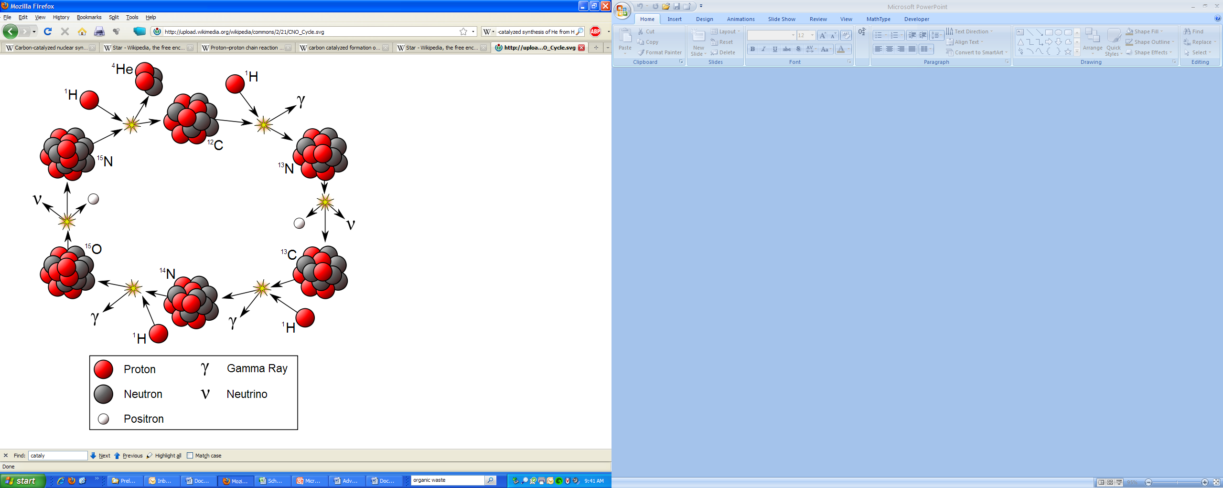
From Wikipedia

Slide 44
Section 1.1 Objectives
Given the reaction,
explain how carbon dating works.
14
7
+
1
0
→
14
6
+
1
1
N
n
C
p
Source of neutrons: cosmic rays (mainly protons) hit O-16, producing neutrons, among other things.--From Wikipedia
Notes:
Needs figures/diagrams for explanation

Slide 45


14
7
+
1
0
→
14
6
+
1
1
N
n
C
p
O₂
Fraction of ¹⁴CO₂ in
atmosphere is constant
CO₂
¹⁴CO₂
t_{½} = 5730 y
t_{½} = 5730 y
Notes:
Reverse reaction takes place, forming N-14.

Slide 46
Chapter 1: Atomic Structure
1.1 The nucleosynthesis of light elements
1.2 The nucleosynthesis of heavy elements
1.3 Spectroscopic information
1.4 Some principles of quantum mechanics
1.5 Atomic orbitals
1.6 Penetration and shielding
1.7 The building-up principle
1.8 The classification of the elements
1.9 Atomic parameters
Notes:
Mention supernova.

